Slide 1
Data Presentation
Part 2

Slide 2
Learning outcomes
Know the appropriate tool for data presentation
Exploring fact from data

Slide 3
Contents
Construction of Frequency Distribution for qualitative data
Graphical presentation of qualitative data
Time series data and Line graph
Uses of Diagrams

Slide 4
Frequency for qualitative data
The following data give the blood group of 40 students:
O, A, B, AB, O, A, O, B, AB, B, O, A, A, B, O, B, A, AB, O, AB,
A, O, O, A, B, B, A, O, AB, O, A, O, O, A, B, O, O, B, AB, B
Construct a frequency distribution.
Blood types | Tally | Frequency
O | |||| |||| |||| | 14
A | |||| |||| | 10
B | |||| |||| | 10
AB | |||| | | 6
Total |  | n=40

Slide 5
Home work
The following data give the number of shoes in different sizes sold by a shop on last one week:
L, M, S, M,M, S, L, L, S, M,M S, L, M, M, S, L, S, M, M, M, M, S, L, S, S, S, S, M, M, M, L, S, M.
Construct a frequency distribution table for this qualitative data.

Slide 6
Graphical presentation of qualitative data
Two types of graphical presentation for qualitative data are:
1. Bar Diagram
2. Pie chart

Slide 7
bar chart
Draw a horizontal axis and label the categories below the line at regularly spaced interval.
Draw a vertical axis and label the scale using frequency.
Draw a rectangular bar above each category label whose height equals the frequency of that category. The bars are the same width and do not touch each other.
Label the horizontal axis with variable name and vertical axis with frequency.

Slide 8
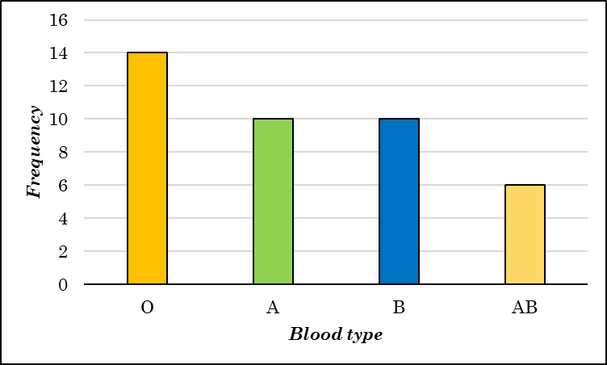
example
Blood types | Frequency
O | 14
A | 10
B | 10
AB | 6
Total | n=40

Slide 9
Pie chart
Draw a circle to represent the whole data set.
For each category, calculate the “slice” size. A circle has 360 degrees. So, Slice size=360×Relative Frequency
Dividing the circle into slices according to their sizes.
Label the slices with the distinct categories and their relative frequencies (percentage frequencies).

Slide 10
Example
Blood types | Frequency | Relative Frequency
O | 14 | 14/40=0.35
A | 10 | 0.25
B | 10 | 0.25
AB | 6 | 0.15
Total | n=40

Slide 11
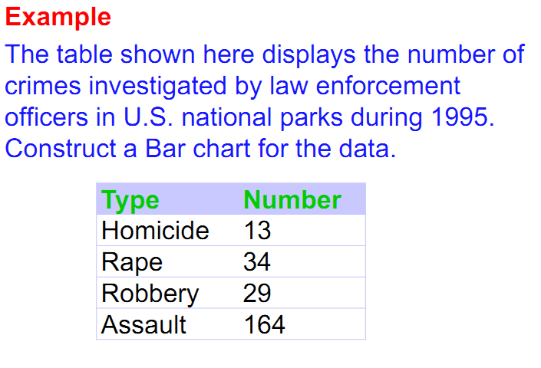
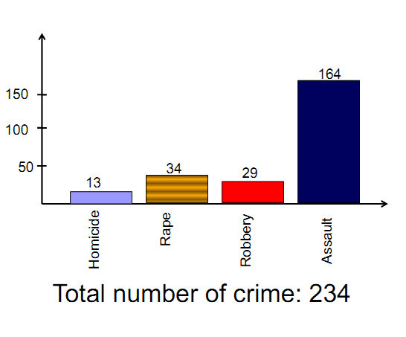
More example

Slide 12
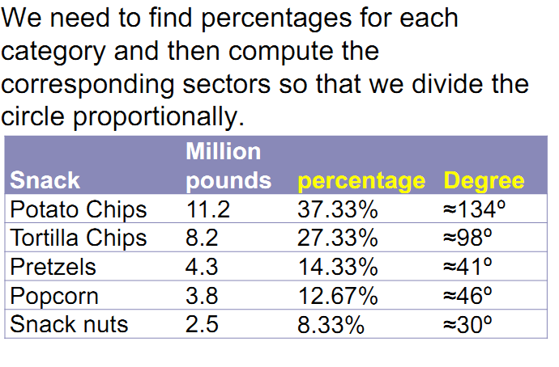
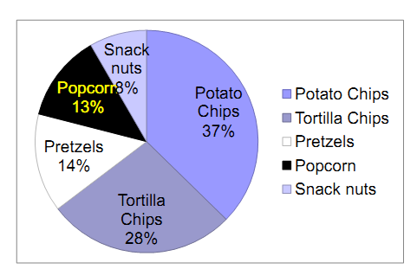
More example

Slide 13
Time series data
A time series data is simply a series of data points ordered in time. Most commonly, a time series is a sequence taken at successive equally spaced points in time. Thus it is a sequence of discrete-time data.
Imagine a CSE student is conducting a study on the performance of a computer system. The student records the CPU (Central Processing Unit) usage of the computer at regular intervals over the course of a day. The data is collected every 5 minutes. Here's a simplified representation of the time series data:
Time | CPU Usage (%)
8:00 AM | 20
8:05 AM | 25
8:10 AM | 30
8:15 AM | 35
... | ...
7:50 PM | 70
7:55 PM | 65
8:00 PM | 60

Slide 14
Line graph
A line graph is a type of chart used to show information that changes over time. So Time series data can be drawn by Line Graph.

Slide 15
EXTRA
Difference between……
Use of ……
Merits and demerits of ……

Slide 16
Some exercise Problems to solve
A country has four political parties say A, B ,C, D. An opinion survey was conducted on 30 people randomly. The data were obtained as follows:
B, C, A, B, A, C, D, A, A, B, C, A, B, C, D, A, A, B, C, A, B, D, A, A, A, D, C, D, B, A.
Construct a frequency distribution table.
Which one is the most popular party based on the survey?
What is the percentage of people liked party B?
Construct an appropriate graph.

Slide 17
Some exercise Problems to solve

Slide 18
Thank You

